Slide 1
AI PROJECT - FAKE CURRENCY DETECTION
USING MACHINE LEARNING
DONE BY:
1. RA1911030010031 – MURALIDHARAN M
2. RA1911030010005 – KESHAV BALAJI BABU
3. RA1911030010016 – SIRPHY S
4. RA1911030010028 – VRUSHAL NEDUNGADI

Slide 2
PROBLEM STATEMENT
Fake Currency Detection is a task of binary classification in machine learning. If we have enough data on real and fake banknotes, we can use that data to train a model that can classify the new banknotes as real or fake.

Slide 3
PURPOSE OF THE PROBLEM STATEMENT – SOCIETAL BENEFIT
Fake Currency Detection is a real problem for both individuals and businesses. Counterfeiters are constantly finding new methods and techniques to produce counterfeit banknotes, which are essentially indistinguishable from real money. At least for the human eye.

Slide 4
Some of the ill-effects that counterfeit money has on society include:
Companies are not being reimbursed for counterfeits. This has led to companies losing buying power. As such, there is a reduction in the value of real money.
Increase in prices (inflation) due to more money getting circulated in the economy—an unauthorized artificial increase in the money supply.
A decrease in the acceptability (satisfactoriness) of money—payees may demand electronic transfers of real money or payment in another currency (or even payment in precious metals such as gold).

Slide 5
ABSTRACT
The dataset we will use in this task for fake currency detection contains these four input characteristics:
The variance of the image transformed into wavelets
The asymmetry of the image transformed into wavelets
Kurtosis of the image transformed into wavelets
Image entropy
The target value is simply 0 for real banknotes and 1 for fake banknotes.
This dataset is furrther processed to get a perfectly balanced dataset which can be used for training the model using LOGISTIC REGRESSION.

Slide 6
Graphical representation of collected data(pair diagram)

Slide 7
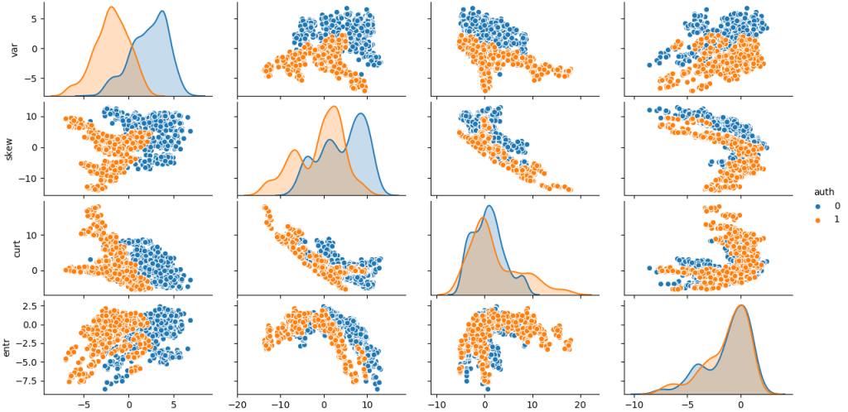
Here it depicts the relationship between all entities
(BLUE FOR GENUINE BANKNOTES AND ORANGE FOR COUNTERFEIT BANKNOTES)

Slide 8
Graphical representation of distirbution of the target values

Slide 9
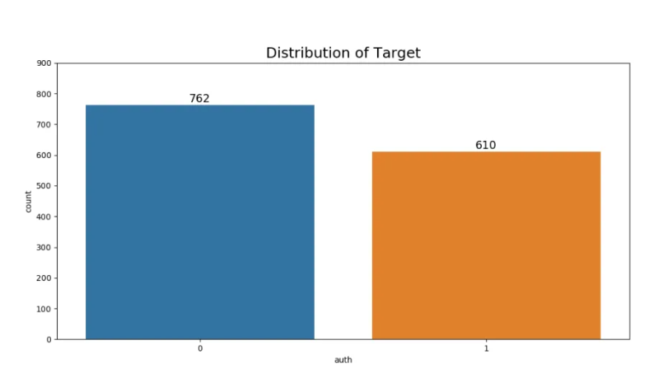
The dataset is fairly balanced, but for the binary classification task, we need to balance it perfectly. So the data is preprocessed to do that.

Slide 10
Data pre-processing and training the model
The dataset is pre-processed using random undersampling. This is done by dropping a number of instances of the overrepresented target functionling.
After dividing the dataset into train and test, we standardize the data using the StandardScalar method provided by Scikit-learn.
After this, we train and test our model for fake currency detection by using the Logistic Regressing Algorithm.

Slide 11
results
The logistic regression model achieved an accuracy of 98.36%. And not only that, when our fake currency detection model predicted that a banknote was real, it was correct 100% of the time.

Slide 12
Thank you

